Slide 1
MIA 5100 — MACHINE LEARNING · GROUP PROJECT
Snap-to-Sell
Turning a corner-store product photo into a priced, image-upgraded, publishable listing
Hands-On AI System Development Project — Build & Evaluate
Ikenna Okonkwo · Loic Tiemani · Frank Boahen · Adhikary Adhikary
University of Ottawa
Notes:
Snap-to-Sell: a pipeline that takes a single phone photo of a packaged corner-store product and returns a publishable sales listing — identity, description, a defensible price, a clean catalogue image, and compliance flags. Build-and-evaluate stream: the contribution is integration, grounding, and rigorous failure analysis.

Slide 2
Adhikary
INTRODUCTION & BACKGROUND
Selling online should be one photo away
Independent corner stores increasingly want to sell online
— through delivery platforms, their own storefronts, or aggregator catalogues.
Hundreds
of SKUs per store, mostly packaged FMCG
But onboarding inventory is manual and slow.
A typical shop carries hundreds of fast-moving packaged goods. Creating each catalogue entry by hand — the right name, a description, a price, an image — is slow enough that most small retailers never digitise their stock at all.
4 stages
recognise → retrieve → generate → verify
Modern vision-language models can already read packaging. The gap is turning that capability into a reliable, deployable pipeline.
1 photo
in → publishable listing out
2
Notes:
Set the scene: demand is real, the bottleneck is manual catalogue creation. Recognising 'a chocolate bar' is trivial; recognising the exact SKU, pulling a realistic local price, and writing copy that doesn't misrepresent is where it gets hard.

Slide 3
Adhikary
PROBLEM STATEMENT & MOTIVATION
The hard part isn't seeing — it's being exactly right
Core question: Can a single photo of a packaged product be turned — automatically and accurately enough to be useful — into a publishable listing with a defensible suggested price?
?
?
?
Which SKU?
Which price?
Which claims?
Brand, variant and pack size — not just the category. This is where accuracy degrades.
A realistic local price, grounded in comparables — never a single confident guess.
Copy that never invents specs or ingredients — misrepresentation is a real harm when selling.
3
Notes:
The problem sits on the gap between off-the-shelf AI capability and real deployment. Three sub-problems: exact identity, defensible price, grounded copy. Solving it lowers the e-commerce barrier for retailers automation usually leaves behind.

Slide 4
Adhikary
OBJECTIVES
An investigation with an evaluation — not a product build
RESEARCH QUESTION
Build
How accurately can a vision-language + retrieval pipeline identify packaged corner-store products from a single shelf photo and generate a publishable, correctly priced listing — and where, systematically, does it fail?
1
End-to-end pipeline: photo in → structured listing out (identity, attributes, copy, price, clean image, compliance flag).
Quantify
2
Performance on three axes — identification accuracy, price error, listing quality — vs a hand-labelled test set.
Every component leans on an existing model or API. The contribution is the integration, the grounding / pricing logic, and rigorous failure analysis.
Characterise
3
Failure modes: look-alikes, multipack ambiguity, glare, occlusion, own-brand — not one headline number.
Safeguard
4
A responsible-AI layer: detect age-restricted items, flag hallucinated / unverifiable claims before publish.
4
Notes:
State the research question verbatim. Four objectives: build, quantify, characterise failures, safeguard. Emphasise the framing — investigation with evaluation.

Slide 5
Ikenna
RELATED WORK
Each stage is solved — the integrated pipeline is not
Sub-problem
Key prior work (2018–2025)
What it gives us
Listing generation
ModICT (2024): frozen LLM + in-context example
Names our exact risk: generic copy for look-alikes
Recognition
RP2K, CAPG-GP; image + OCR fusion (2023)
Multimodal beats image-only, esp. few-shot
Pricing
LLP (2025): retrieve comparables, reject low-confidence
Validates retrieval-grounded, confidence-gated pricing
Image upgrade
SIR (2020), e-CLIP (2022): embedding match
Same-SKU match + restricted-item detection
The gap: no published system chains recognition → comparable pricing → verified image replacement → grounded generation into one evaluated pipeline. Commercial snap-to-sell apps target used goods, are closed, and publish no evaluation.
5
Notes:
Ten papers across four sub-problems support each design choice. Novelty: the integrated, measured pipeline for corner-store FMCG, with same-SKU verification and selling-context responsible-AI as first-class evaluated concerns.

Slide 6
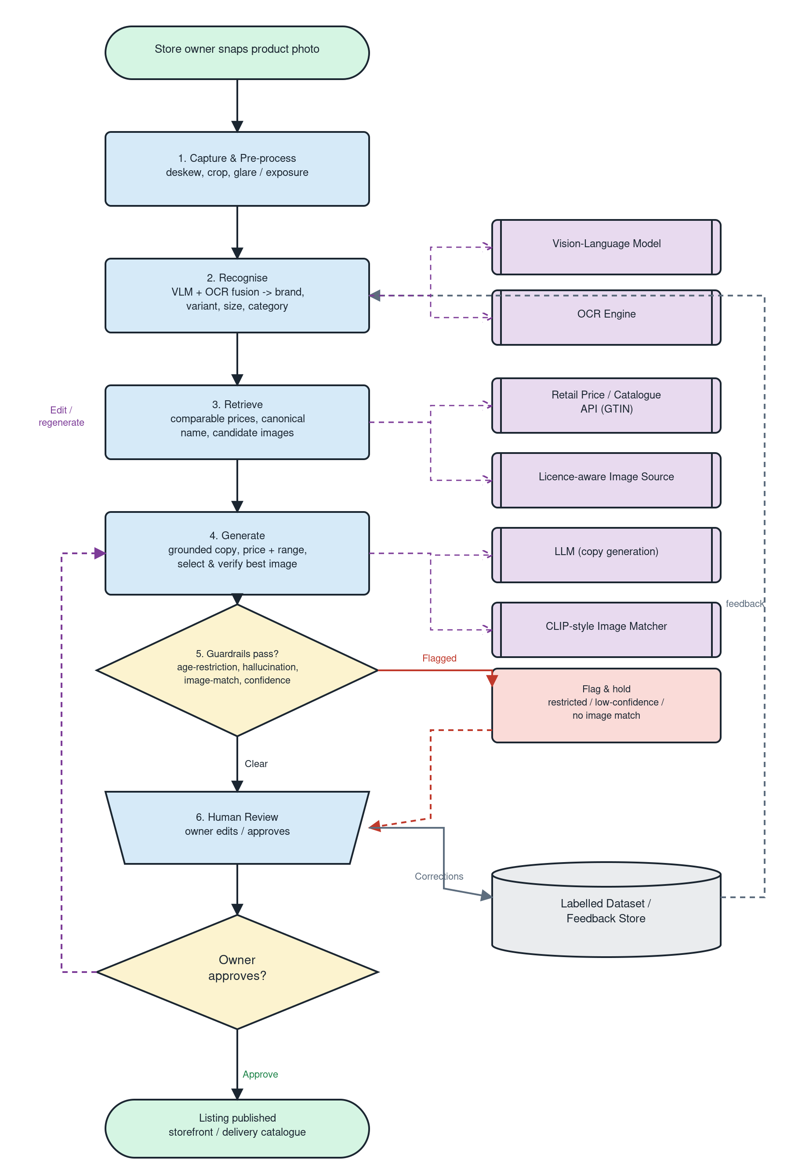
Ikenna
SYSTEM DESIGN
A staged pipeline with human review
1
Capture
Phone image; deskew, crop, glare / exposure normalise
2
Recognise
VLM + packaging OCR → brand, product, variant, size, category
3
Retrieve
Barcode-first lookup → comparable prices, canonical name, candidate images
4
Generate
Grounded LLM copy + price range; select & verify best catalogue image
5
Guardrail
Age-restriction, hallucination & image-match checks; low-confidence routing
6
Human review
Owner edits / approves; corrections feed back as labelled data
6
Notes:
Walk the six stages. Key design choices: VLM+OCR fusion over a scratch classifier; grounding generation in retrieved attributes; price as estimate-with-range; image swap only on a confident same-SKU match with the owner's photo as fallback.

Slide 7
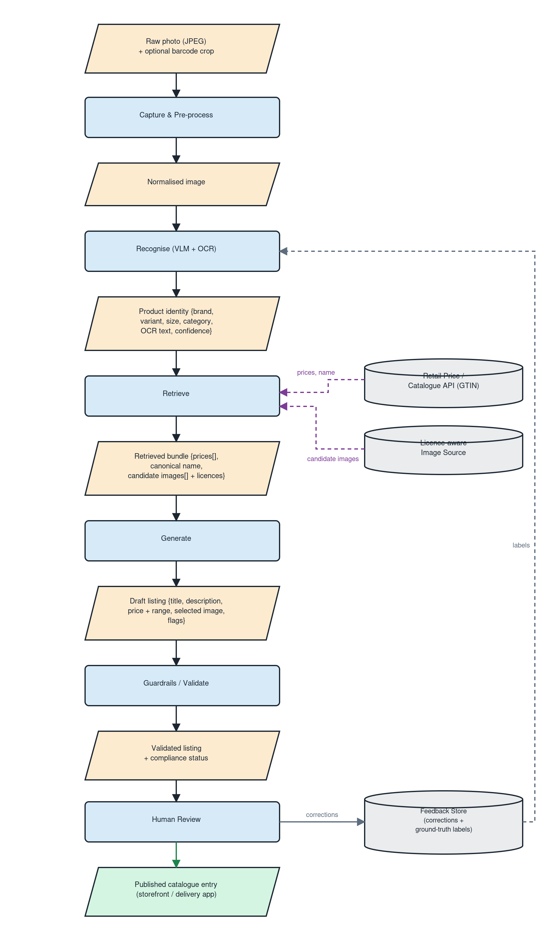
Ikenna
SYSTEM DESIGN
What flows between the stages
Every stage exchanges a typed artifact — the interfaces are frozen so components can be built and tested independently.
Photo
normalised image + optional barcode crop
Identity
brand · product · variant · size · category · confidence · query
Bundle
canonical name · price + currency · candidate images · ambiguity flag
Draft listing
title · description · suggested price · best image
Flags
age-restricted · claim-grounded · image-swapped · route-to-review
7
Notes:
The data contract. Typed artifacts between stages mean each module can be developed and tested in isolation behind a frozen interface.

Slide 8
Loic
METHODOLOGY
CRISP-DM, adapted for assembled pretrained components
1
2
3
Problem understanding
Data understanding
Data preparation
Lock category, success criteria, responsible-AI requirements
Assemble & profile candidate images and price references; find look-alike clusters
Build the labelled test set (photo → SKU + real observed price); define quality rubric
4
5
6
Modelling
Evaluation
Deployment (academic)
Assemble stages; compare VLM-only vs VLM+OCR, retrieved-median vs adjusted pricing
Score on held-out set; failure-mode analysis; compare to a naive baseline
IEEE paper, timed presentation, documented reproducible codebase + demo
8
Notes:
Six CRISP-DM phases. Note the data-strategy honesty: no ready-made 'corner-store photo → listing + price' dataset exists, so building the labelled test set with real observed prices is itself part of the contribution.

Slide 9
Loic
IMPLEMENTATION DETAILS
How it is actually built
Recognition
Hosted vision-language model (default GPT-4o-mini; Claude / Gemini optional) fused with packaging OCR → structured identity JSON.
STACK
Python 3.12 · src/ package
OpenCV — capture
Hosted VLM + OCR — recognise
OFF / OPF / Open Prices + Shopping API — retrieve
CLIP / phash + rembg — imagematch
Structured-output LLM — generate
Guardrail + trace layer
Notebooks (local + Colab) demo
Retrieval
Barcode-first lookup across Open Food Facts / Open Products Facts / Open Prices, plus a bounded Google Shopping layer; N-best re-ranking with retailer & local-currency preference.
Generation
LLM with structured-output prompting, grounded strictly in retrieved / extracted attributes — no invented specs.
Image upgrade
CLIP-style similarity + perceptual hash to verify same-SKU; background removal (rembg) to clean the owner's own photo; quality gate before any swap.
Guardrails
Age-restriction flag, claim-grounding, ambiguity → human review; per-image trace log for every decision.
9
Notes:
A genuinely runnable pipeline, not a mock. Hosted providers are pluggable; retrieval is barcode-first with graceful offline fallbacks; generation is grounded; image swap gated on same-SKU verification; every run writes a per-image trace log.

Slide 10
Loic
RESPONSIBLE AI
Safety treated as a first-class, measured concern
!
Age-restricted items
✓
No misrepresentation
Tobacco and similar are detected and flagged — never a silent publishable listing for a restricted product.
Generation is grounded in retrieved attributes; unverifiable claims are flagged before review.
⤢
Right image, licensed
$
Transparent pricing
Same-SKU match blocks wrong-product images; only licence-clear sources adopted; false-swap rate measured.
Prices shown as ranges with the basis, so the owner makes the final call.
10
Notes:
In a selling context, an invented spec or a wrong image is a real harm. Four safeguards, each measurable — age-restriction recall, hallucinated-claim catch rate, false-swap rate, priced-as-range transparency.

Slide 11
Loic
EVALUATION
Seven axes, anchored by a naive baseline
Identification
Top-1 / Top-3 SKU accuracy; brand vs variant level
Attribute extraction
Field-level precision / recall (size, flavour, count)
Price estimation
Median abs. % error vs real observed price; % in band
Listing quality
Blind human rubric: accuracy, completeness, no hallucination
Image upgrade
Match accuracy; % upgraded; false-swap rate (penalised)
Responsible AI
Age-restricted recall; hallucinated-claim catch rate
Efficiency
Latency and approximate cost per item
Naive baseline: VLM caption → generic listing, no retrieval grounding, no guardrails. Every improvement is measured against it, so gains are attributable — not a single headline number.
11
Notes:
Report per-axis, not one number. Safety axes weighted heavily. The naive baseline anchors every comparison. Failure modes analysed, not averaged away.

Slide 12
Frank
RESULTS
Results — 58-item corner-store test set
Live run: OpenAI gpt-4o-mini (recognition + generation) + Google Shopping retrieval; n = 58 hand-labelled products, scored against the naive VLM-caption baseline. Winner per row in green.
Metric
Naive baseline
Snap-to-Sell
Top-1 identification accuracy
84.5%
86.2%
Category accuracy
77.6%
79.3%
Age-restriction recall
0%
100%
Image-upgrade (swap) rate
0%
29.3%
Price — median abs. % error
22.4%
43.1%
Price — mean abs. % error
47.4%
359.9%
Takeaway: Snap-to-Sell beats the baseline on identification, category, age-restriction flagging (100% recall), and image upgrade. It loses on price — retrieval-grounded pricing underperforms a VLM guess on low-value FMCG (multipack / look-alike matches); 8 low-confidence matches were declined and routed to review.
Top-3 accuracy and blind listing-quality rating not yet automated; 'swap rate' shown (false-swap rate needs per-image correctness labels).
12
Notes:
Headline: the pipeline wins 4 of 5 measured axes over the naive baseline — identification, category, age-restriction recall (100%), and image upgrade. Be candid on price: the baseline's ungrounded VLM guess beats retrieval-grounded pricing on cheap corner-store goods, because Google Shopping keeps returning multipacks and look-alikes. That's a documented failure mode, and low-confidence matches are declined (routed to review) rather than mispriced. n=58; report median (robust) and mean (outlier-sensitive).

Slide 13
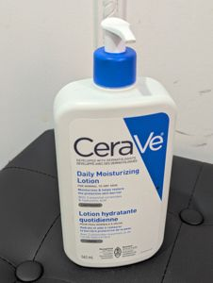
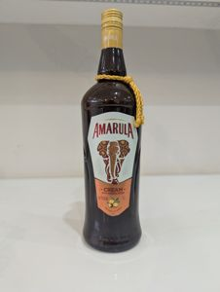
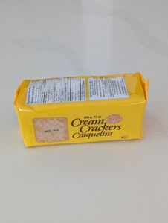
Frank
RESULTS
Qualitative results — photo in, listing out
Recognised → published
Age-restricted → flagged + image upgraded
Low confidence → routed to review
HOUSEHOLD
ALCOHOL
SNACKS
CeraVe Daily Moisturizing Lotion, 562 mL
Amarula Cream Liqueur, 1 L
Cream Crackers, 200 g (brand unconfirmed)
CAD 43.72
CAD 37.15
— routed to review
ready to publish
18+ restricted
catalogue image
needs review
13
Every output carries its evidence — recognised identity + OCR, ranked candidates, price basis, image-match reason, and guardrail flags — logged per item and rendered in an HTML run report.
Notes:
Real pipeline output: (1) a clean publish-ready listing; (2) an alcohol item correctly flagged 18+ with a verified catalogue image swapped in; (3) an unbranded item the confidence gate declined to price and routed to human review. This is the qualitative 'predictions / visualizations' the rubric asks for, and it sets up the interpretability point next.

Slide 14
Frank
DISCUSSION
What actually broke — and what held
Multipack / case pricing
Look-alike comparables
Unbranded / regional items
Shopping returned 24-packs and cases for single units — the main price-error driver. Per-unit normalization helps; wrong comparables persist.
Visually similar wrong products (a kayak for an unbranded cracker) anchored bad prices; the outlier + brand gate reject the worst.
No confident brand match → declined to price and routed to review (8 of 58 items).
Age-restricted retrieval
Low-res catalogue images
What held
Cigarettes / alcohol aren't on shopping search → junk hits — but the guardrail still flagged 100% of them.
Shopping thumbnails are small; enhance mode keeps the owner's sharper photo, so swaps happen mainly in swap mode.
Identification (86%), category (79%) and age-restriction recall (100%) were robust across all six categories.
Mitigations: per-unit price normalization, price-outlier rejection, brand-confirmation gate (decline + route to review), robust median reporting.
Interpretability & explainability: the pipeline is white-box by construction — no black-box score decides a listing. Each output exposes its evidence: recognised attributes + OCR text, the ranked retrieval candidates with scores, the stated price basis, the LLM's same-SKU match reason, and explicit guardrail flags — all captured in a per-item trace log and an HTML run report for human review.
14
Notes:
Observed failure modes from the 58-item run, not predictions. Lead with pricing — the one axis the baseline won, honestly a retrieval-quality problem on cheap FMCG, not a modelling flaw. Then explicitly address interpretability/explainability (a rubric requirement): the whole pipeline is inspectable — trace logs, candidate scores, price basis, match reasons, guardrail flags — nothing is a black box.

Slide 15
SUMMARY & CONCLUSION
One photo → a defensible, safe listing
✓
Evaluated on 58 real corner-store products, Snap-to-Sell beats the naive baseline on identification, category, age-restriction recall (100%), and image upgrade.
FUTURE WORK
Wider open-catalogue coverage
Larger labelled test set
Learned price adjustment
Multi-item shelf detection
Live marketplace publishing
✓
Responsible-AI is first-class and measured: every tobacco / alcohol item flagged, and low-confidence matches are declined and routed to human review.
✓
Honestly evaluated: retrieval-grounded pricing is the one axis the baseline wins — a documented failure mode on low-value goods, reported rather than hidden.
Snap-to-Sell — lowering the e-commerce barrier for the retailers automation leaves behind.
15
Notes:
Close on the contribution: integrated, verified, reproducibly evaluated. Future work signals awareness of limitations. End with the mission line.

Slide 16
SELECTED REFERENCES (APA)
References
Chen, S., & Chou, E. (2018). The price is right: Predicting prices with product images.
Li, Y., Hu, B., Luo, W., Ma, L., Ding, Y., & Zhang, M. (2024). A multimodal in-context tuning approach for e-commerce product description generation (ModICT). LREC-COLING 2024. arXiv:2402.13587
Peng, J., Xiao, C., & Li, Y. (2020). RP2K: A large-scale retail product dataset for fine-grained image classification. arXiv:2006.12634
LLP: LLM-based product pricing in e-commerce. (2025). arXiv:2510.09347
SIR: Similar image retrieval for product search in e-commerce. (2020). arXiv:2009.13836
e-CLIP: Large-scale vision-language representation learning in e-commerce. (2022). arXiv:2207.00208
Full list (10 landmark papers, 2018–2025) with verified author lists in docs/literature_review.md · APA per uOttawa guidelines.
16
Notes:
Point to the full literature review for the complete APA list. A few preprint author lists still to be verified before final submission.

